Slide 1
WEB PROGRAMMING
PROJECT

Slide 2
TABLE OF CONTENTS
About Our Project
01
04
Project Stages
02
Major Requirements
Our Team
03
05
Project Goals
We have taken a real life problem into consideration and found it’s solution
From designing skeleton of the website till adding all the css effects with love.
HTML, CSS, JAVASCRIPT,
BOOTSTRAP
Abhishek -M200672CA
Abinash - M200674CA
Daivik - M200690CA
Dewashish -M200691CA
To Provide our juniors with best resources in all subjects.

Slide 3
WHAT WE ARE WORKING ON
RESPONSIVE
ACCESSIBLE
RELIABLE
Multi device accessibility
Accessible right into your hands
From the best tutors and top websites.

Slide 4
ABOUT THE PROJECT
The situation is dire. Everyone is facing and unprecedented crisis, which requires unprecedented support from the us.
We believe all our juniors will gain hardwired curiosity after going through our resources and well structured guidelines of each subject and semesters. We value and believe in learning to learn. We aim further development of coding skills and knowledge of other important subjects such that they end up getting a handsome salary at the end of 3 years.

Slide 5
-By Pele
“Success is no accident. It is hard work, perseverance, learning, studying, sacrifice and most of all, love of what you are doing or learning to do.”

Slide 6

REDIRECTS TO
HOME PAGE
COURSES
COMPETITIVE PROGRAMMING
PLACEMENTS
CONTACT US

Slide 7
NAVIGATION BAR INFO
REDIRECTS TO NITC WEBSITE
REDIRECTS TO USER’S FEEDBACK FORM
REDIRECTS TO OUR TEAM INFO
WEBSITE LOGO

Slide 8
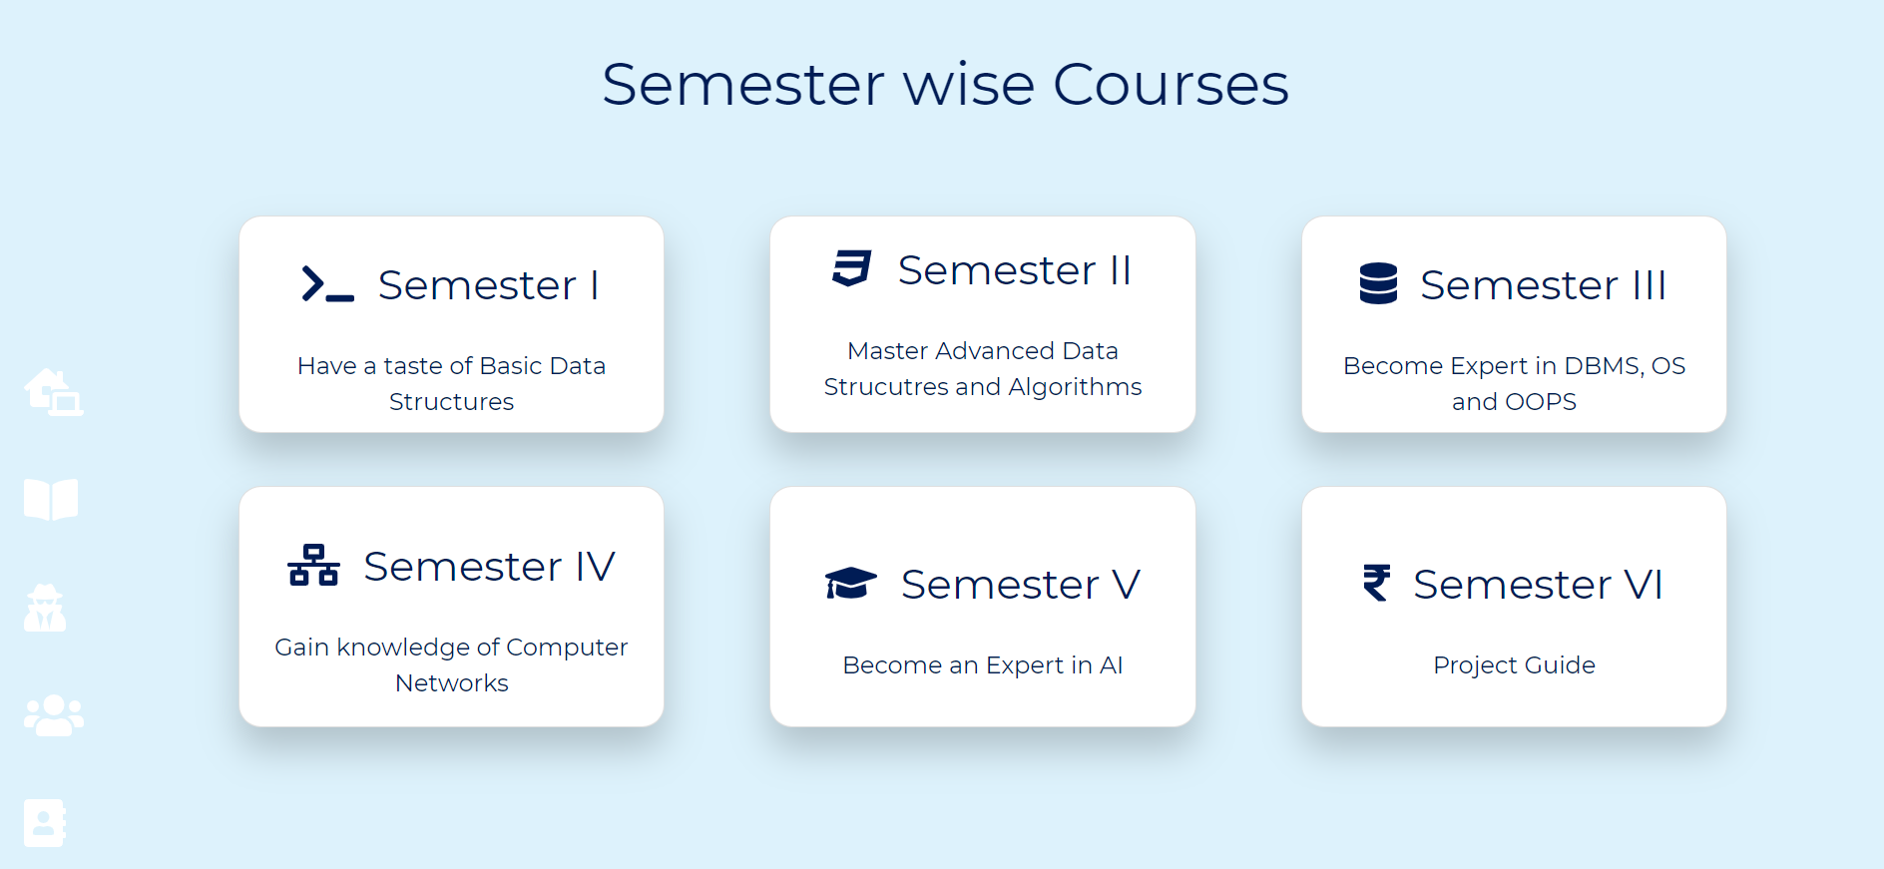
COURSES
IF WE CLICK ON EACH RESPECTIVE BOXES THEN IT’LL REDIRECT US TO ALL THE COURSES OF RESPECTIVE SEMESTERS.

Slide 9
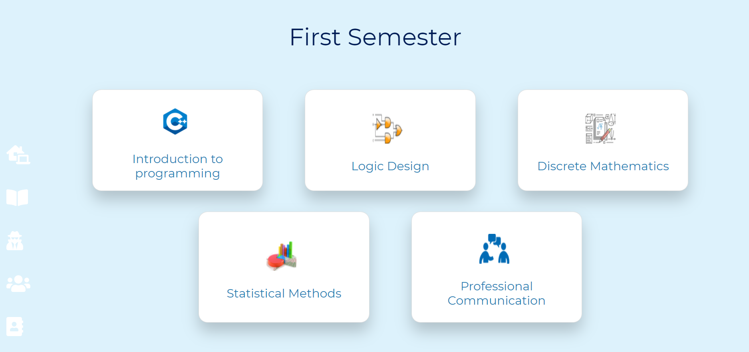
SEMESTER PAGES
WE’VE IMPLEMENTED CARD LINKS TO REDIRECT TO THE COMPLETE ROAD MAPS FOR RESPECTIVE SUBJECTS WHICH ARE INFACT BEAUTIFUL MIND MAPS FOR EASE OF ACCESS FOR THE USERS.

Slide 10
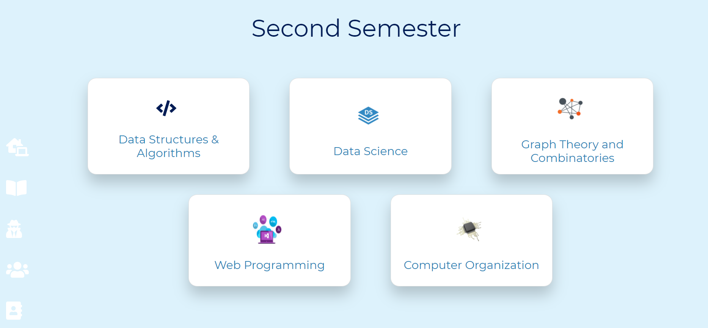

Slide 11
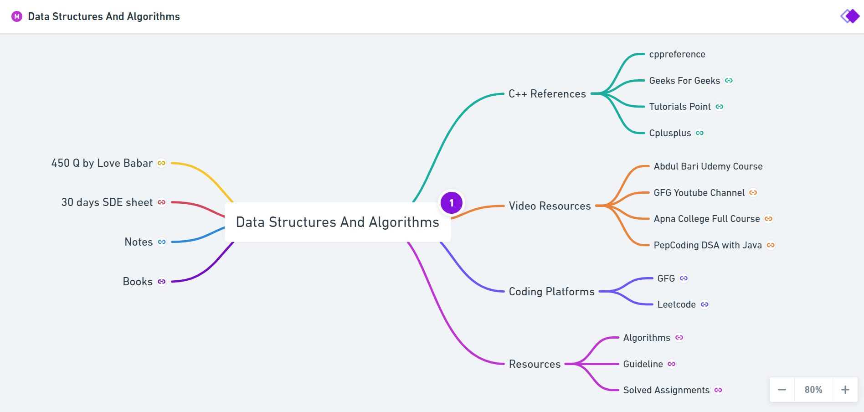
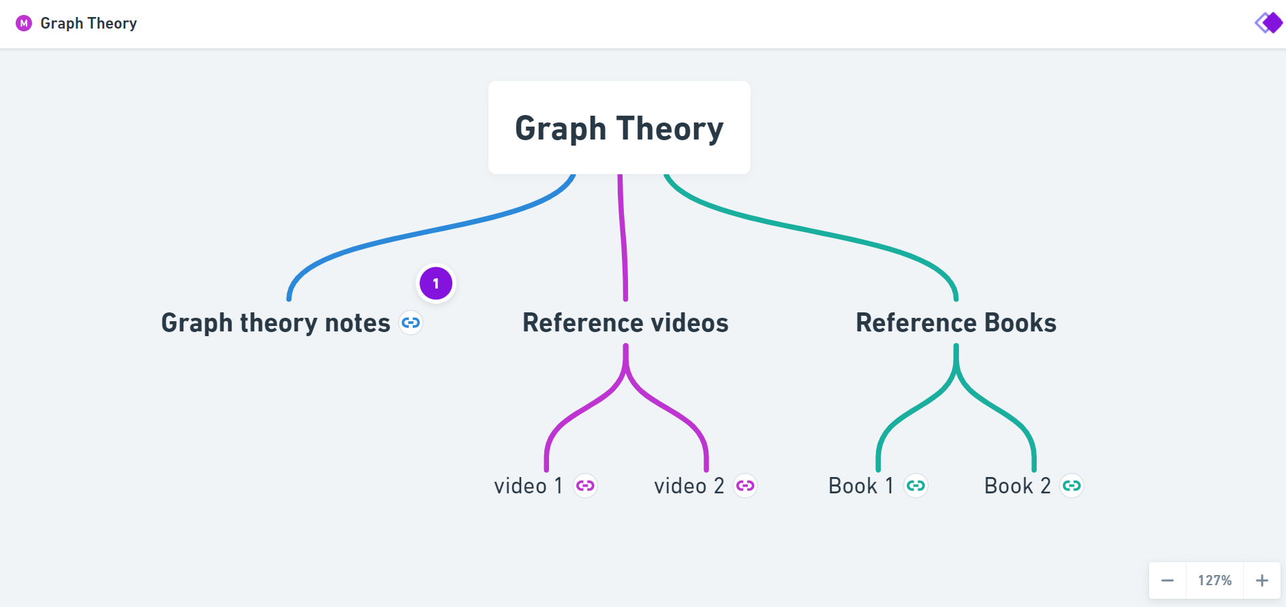
SAMPLE MIND MAPS
These Mind Maps contains redirectable links and google drive links for easy reachable resources.

Slide 12
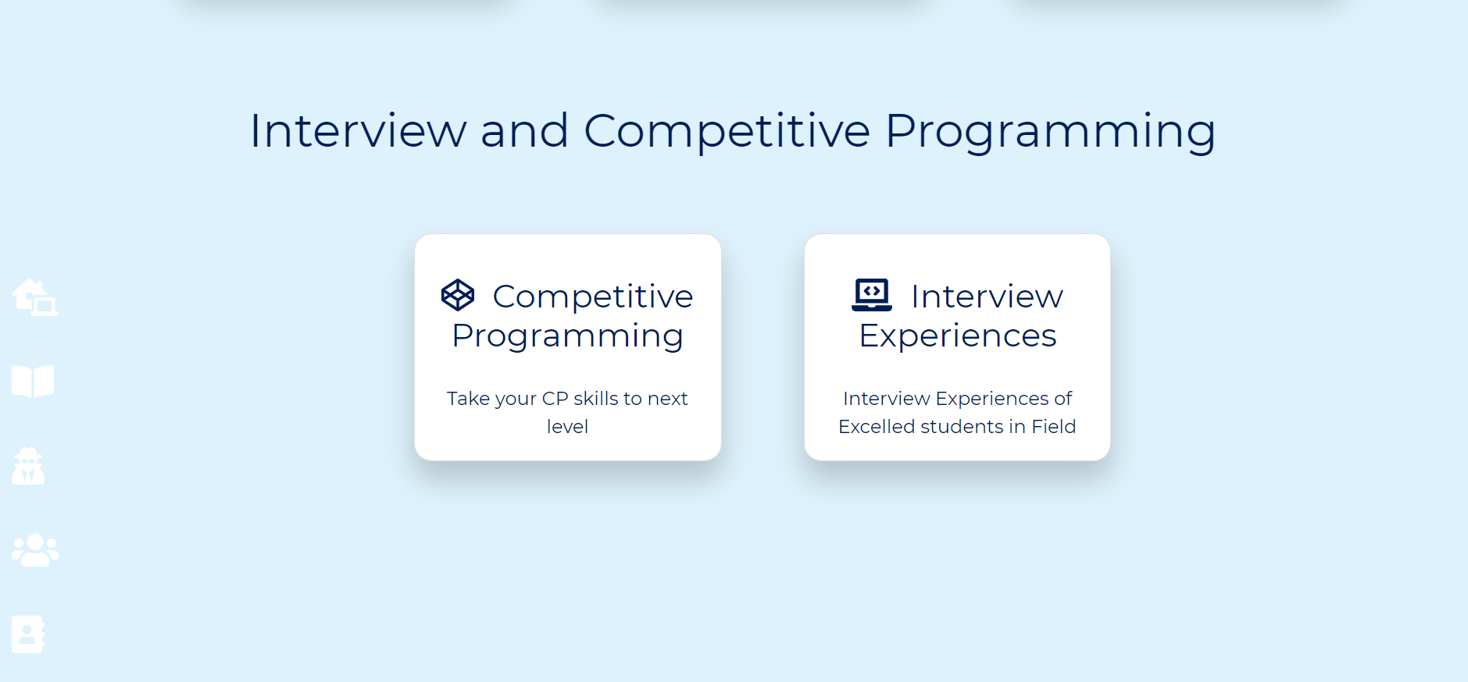
INTERVIEW EXPERIENCE AND CP
THIS ALSO CONTAINS A EVOCATIVE MIND MAP WHICH WILL GUIDE JUNIORS WHO ARE INTERESTED IN DOING COMPETITIVE PROGRAMMING
THIS IS A GFG REDIRECTABLE LINK WHICH CONTAINS INTERVIEW DIARIES OF VARIOUS COMPANIES.

Slide 13
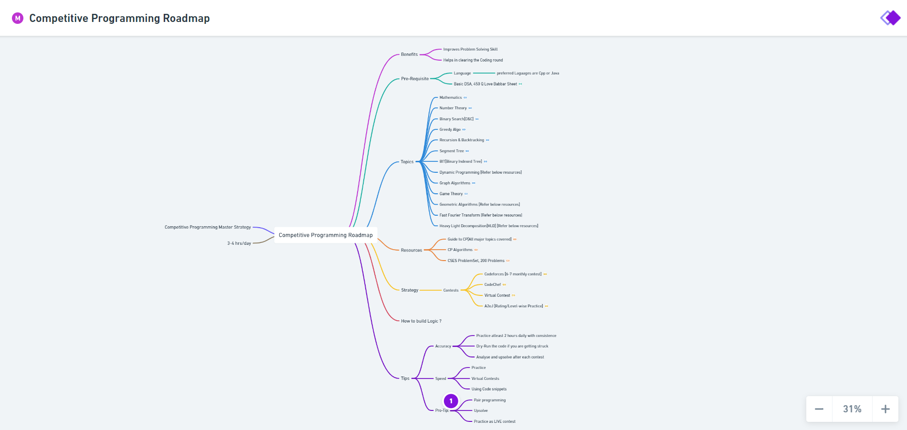
MIND MAP FOR COMPETITIVE PROGRAMMING

Slide 14
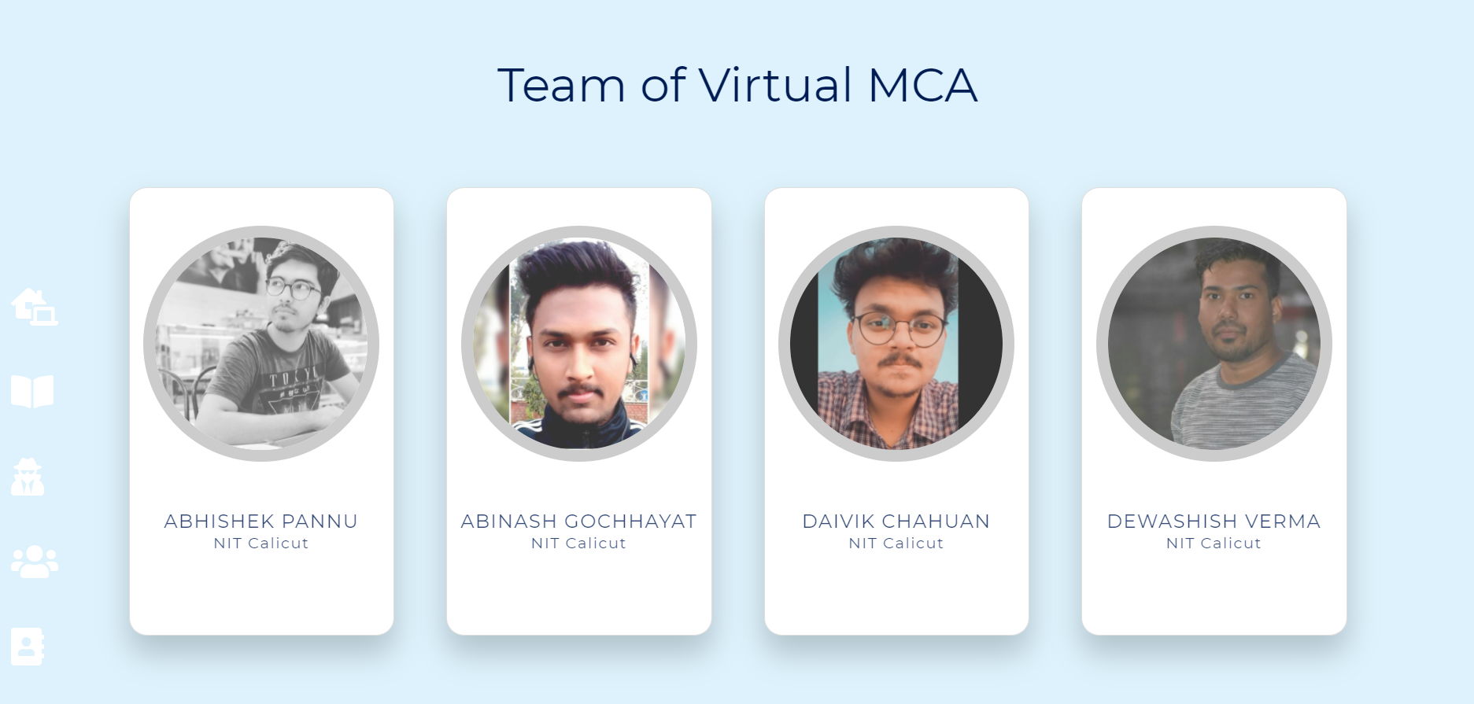
CONTACT US
HEADER
CONTAINS VISUAL EFFECTS
CARD WITH CONTACT LINKS

Slide 15
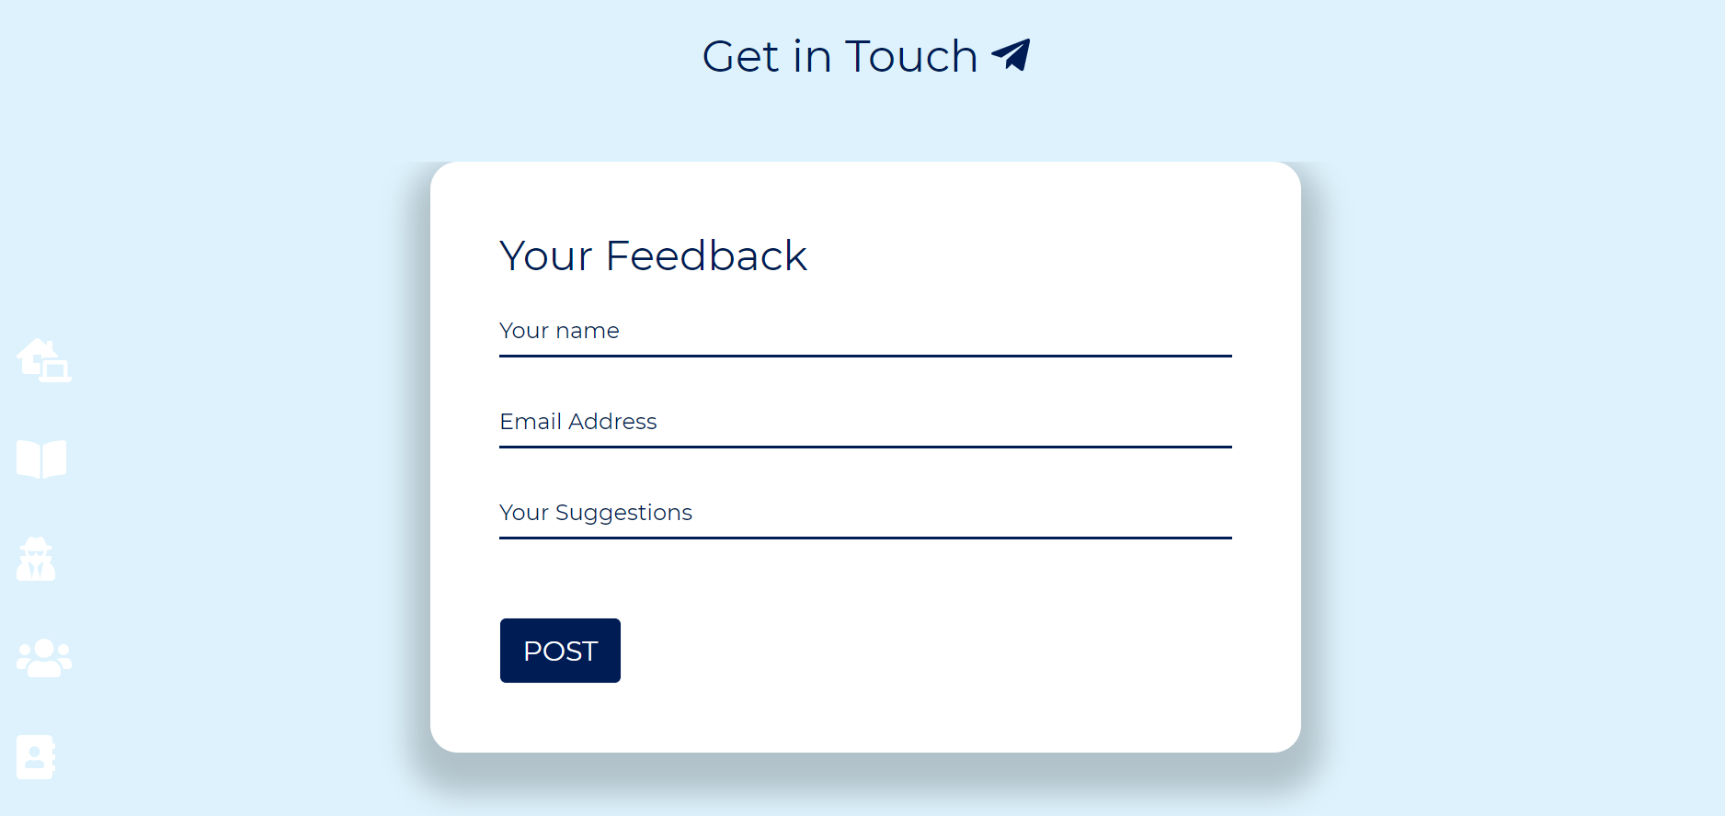
FEEDBACK FORM
FOR ANY TYPES OF SUGGESTIONS THE USER MUST GIVE US THEIR VALUABLE FEEDBACKS. WE’RE WITH ALL EARS.

Slide 16
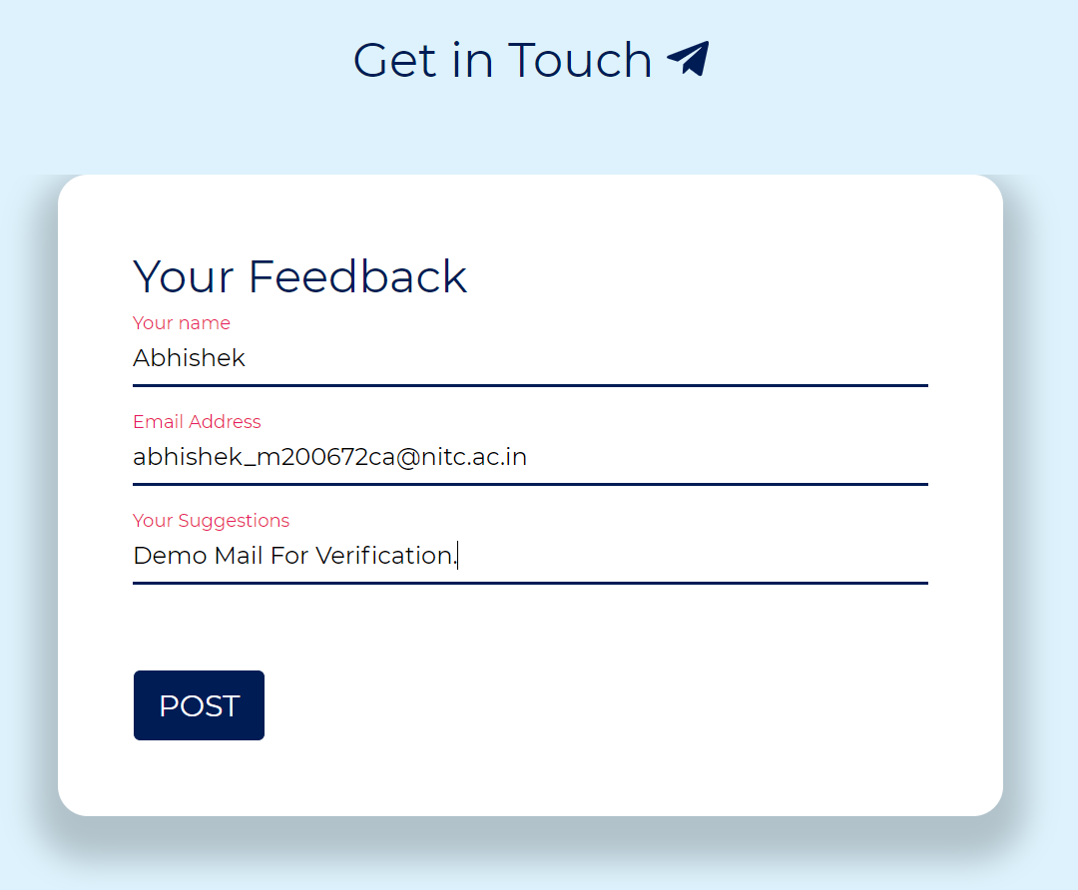
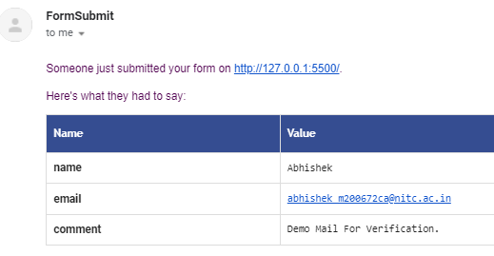
FEEDBACK RECEIVED

Slide 17


Slide 18
THANK YOU!!

